Slide 1
Operating Systems File Management Dr. Shamim Akhter

Slide 2
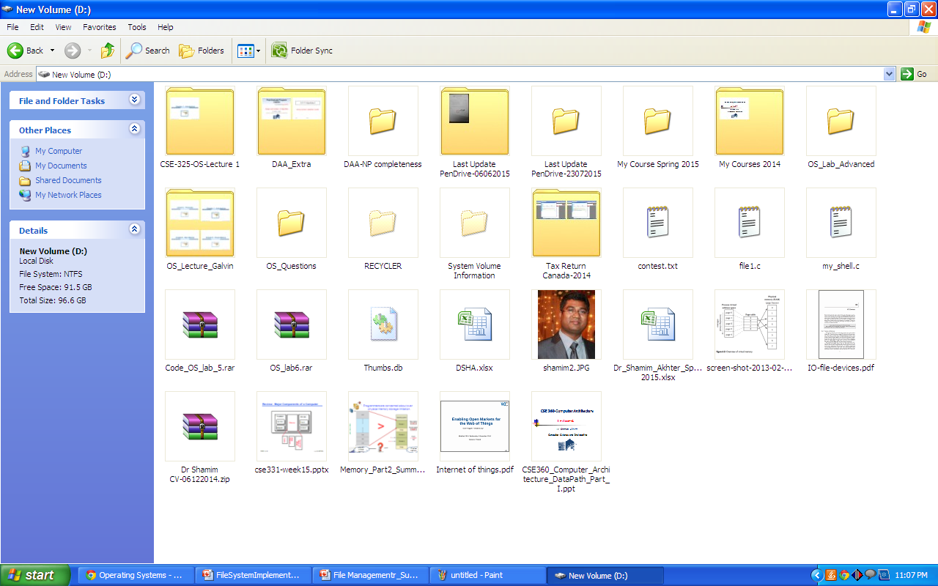

Slide 3

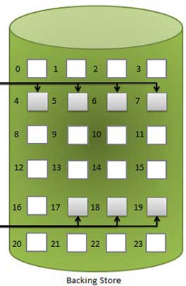



In Computer,
No such a thing, called FILE!!
Operating System/File Manager
@Dr. Shamim Akhter
Creates illusion for FILE existence
Physical View / Memory Location
Uniform Logical View

Slide 4
What is FILE then?
Blocks of allocated memory
@ nonvolatile storage devices
@Dr. Shamim Akhter

Slide 5
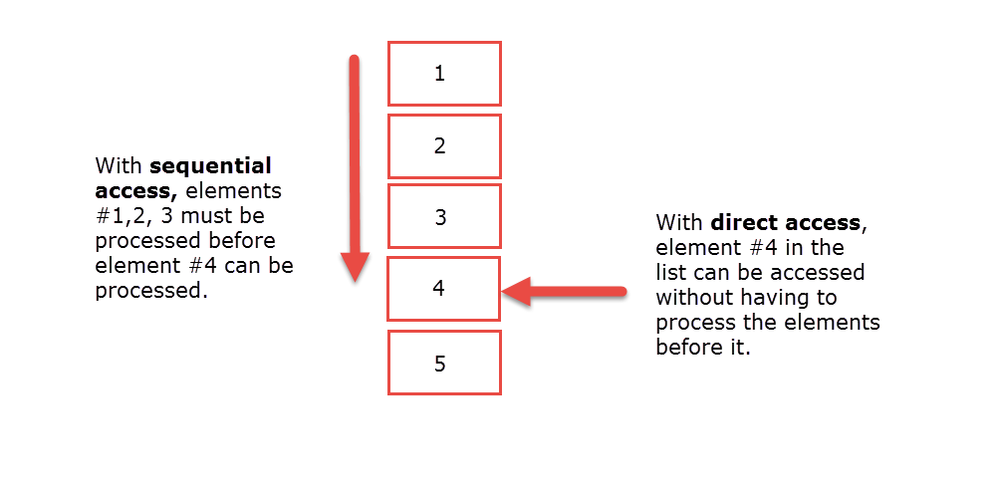
Data Access Methods
Sequential Access
Data accessed in a predetermined, ordered sequence. Example-Magnetic Tape
Direct/Relative Access

Slide 6
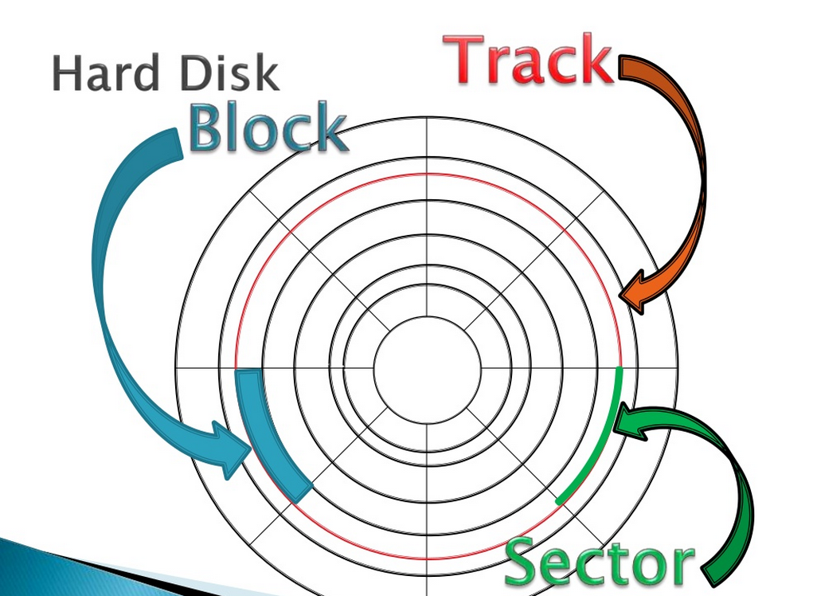
Sector physical storage
Typically 512 bytes
Block used as logical file system to transfer data
Block size = 512 bytes/1024 bytes

Slide 7
Disk Capacity
# of Cylinder= # of tracks per surface/platter
# of tracks per cylinder = Total # of head/ Total # of platter*2
# of sectors per track
# of bytes per sector

Slide 8
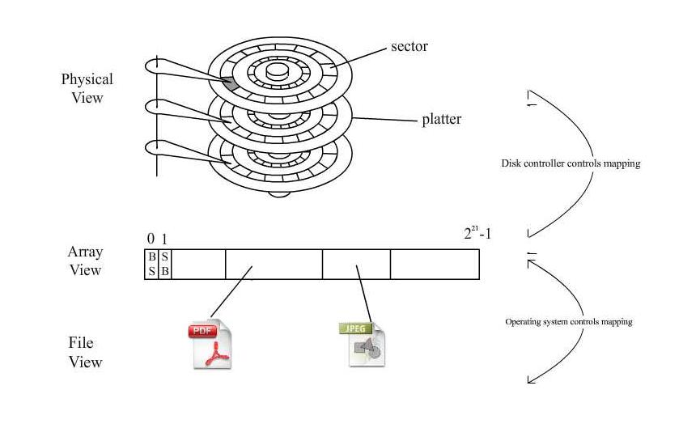

File Systems Overview
http://www.read.cs.ucla.edu/111/2007fall/notes/lec12
Allocated
Unallocated
Sector 0 :the boot sector.
Sector 1 : the superblock.
Superblock contains:
Disk information (size of the disk, size of each sector, owner, etc.)
Location of root directory (starting sector and size)

Slide 9
Physical Storage Allocation
Three main ways a file is physically stored in memory:
Contiguous Allocation
Non-Contiguous Allocation
Linked Allocation
Indexed Allocation

Slide 10
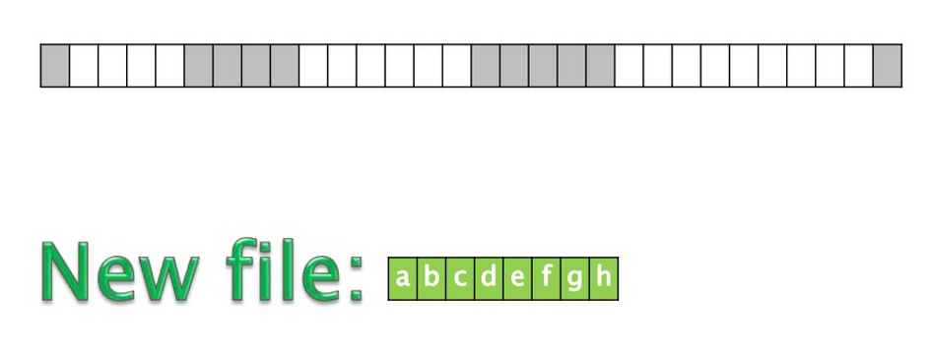
Contiguous Allocation

Slide 11
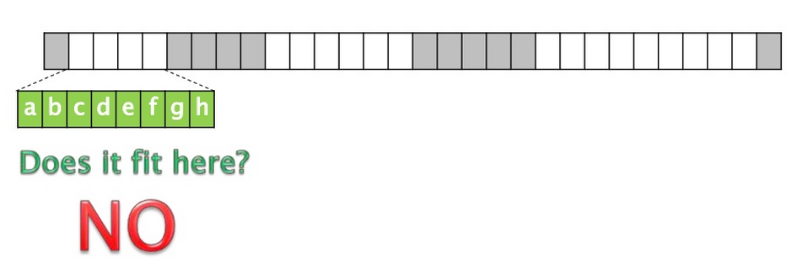
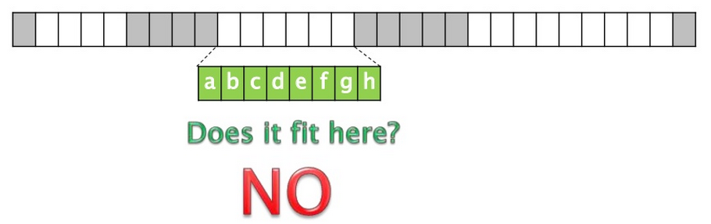
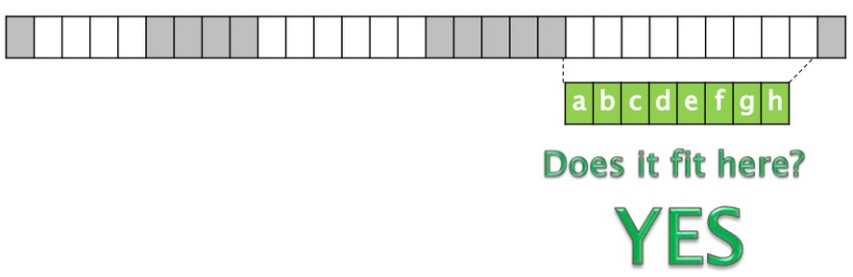
Contiguous Allocation

Slide 12
Contiguous Allocation Problems
External fragmentation
Sol^{n}: Compaction
File size needs to know in advanced
Allocated files are modified and requires memory extension
Sol^{n}:
terminate with error message
find larger hole and shift contents to new place, and release the previous address.

Slide 13
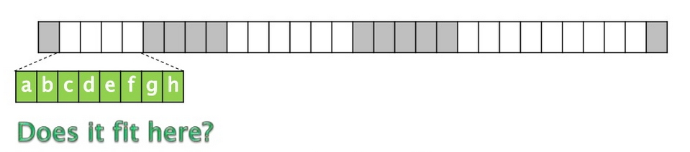
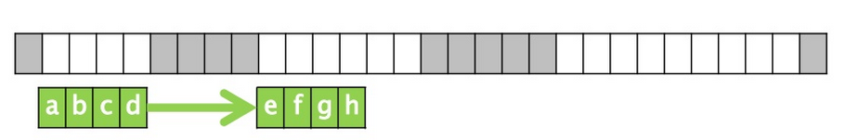

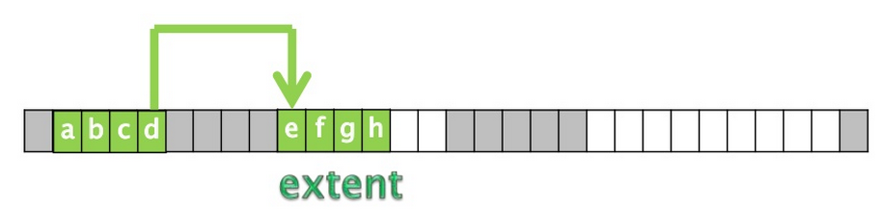
Non-Contiguous Allocation
Large extent:
Internal Fragmentation
Varying size extent:
External Fragmentation

Slide 14
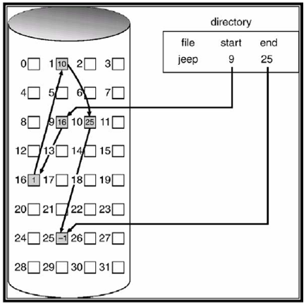
Linked Allocation
1 Block
Data | Pointer
508 | 4
512 Byte

Slide 15
Linked Allocation Problems
File can be accessed only by sequential-access
Allocation Space for pointer
Clusters (with multiple blocks), internal fragmentation
Reliability
pointer lost, damaged
doubly link-list solution but too costly.

Slide 16
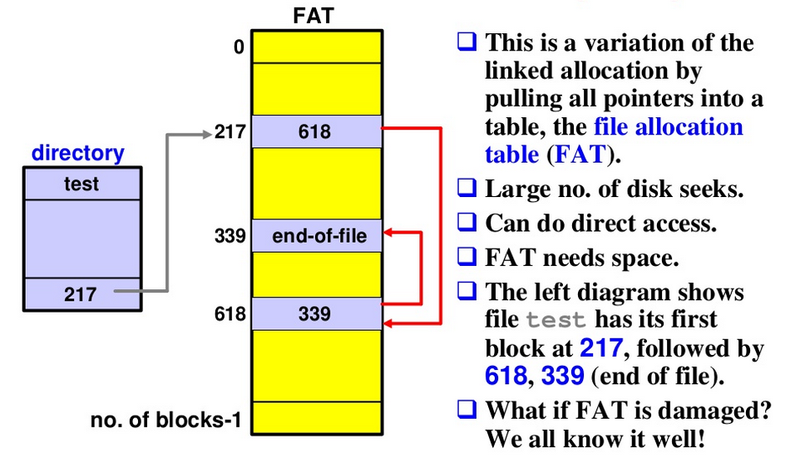
File Allocation Table (FAT)
Details in Lab 9

Slide 17
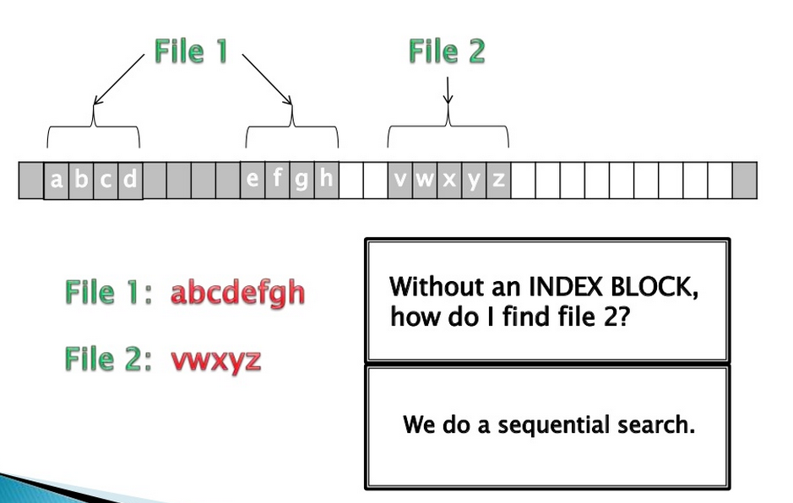
Indexed Allocation

Slide 18
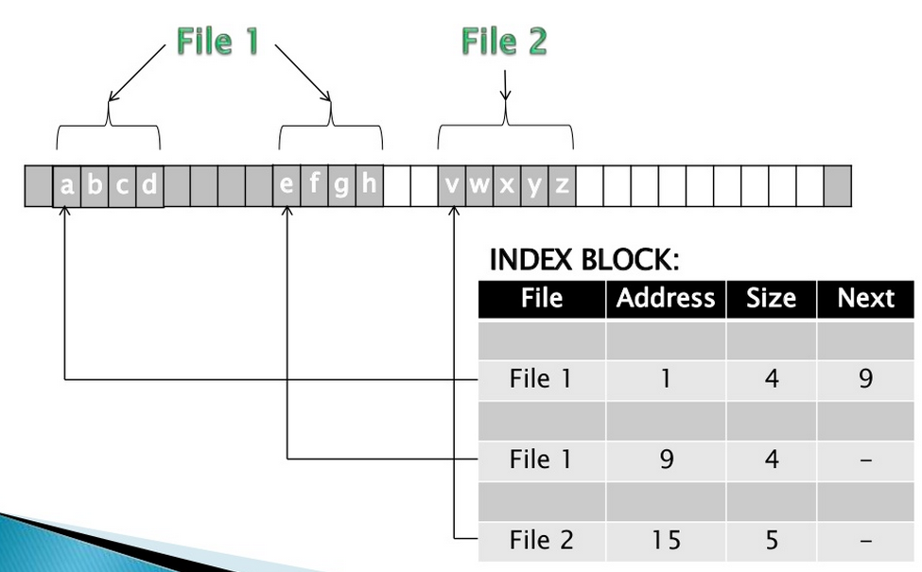
Indexed Allocation
Supports both Sequential and Direct Access

Slide 19
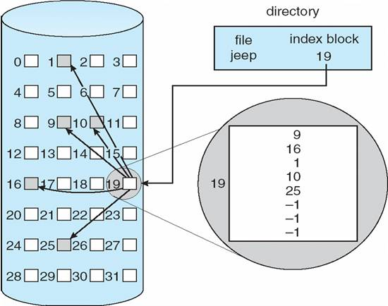
Indexed Allocation
Index Block overhead is higher than linked allocation pointer overhead
Array of index

Slide 20
Given a block size of 512B and 4B pointer is required to point a block. How big can a file be if you have a single index block in an index file management scheme?
Single Index Block= 508/4=127 pointers [last 4B is -1]
Maximum Total File size = 127 x 512 B = 65024 B
Given a block size of 512B and 4B pointer is required to point a block. How big can a file be if you have a double index block in an index file management scheme?
127 x Single Index Block
=127 x 65024 B

